Slide 1


Retention and Reengagement of Nurses in North Carolina: A Data Investigation
Caroline Spencer
Master of Professional Science in Biomedical and Health Informatics Program

Slide 2

Organizational Background
Cecil G. Sheps Center for Health Services Research
Health Workforce Research and Policy Program
Sheps Health Workforce NC
Health Professions Data System (HPDS)
Collects and disseminates descriptive data on licensed healthcare professionals in NC
Maintained in collaboration with NC Area Health Education Centers (AHEC) and NC independent health professional licensing boards

Slide 3
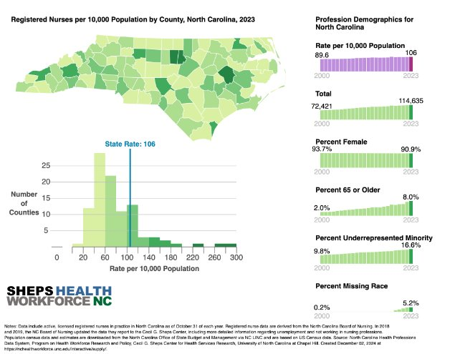
Health Professions Data System (HPDS)
Annual licensing board data for 21 health professions
Aggregated data available online as interactive visualizations and for download
Organizations can request individual level data from HPDS for research projects

Slide 4
HPDS Processing
HPDS Version 1 (Current)
Flat files (Excel, CSV, Text files) received from licensing boards
Processed with SAS code --> SAS data files --> Stata files
Stored as annual and longitudinal flat files for analysis for each profession
HPDS Version 2 (Work in Progress)
Data modernization project to standardize and create longitudinal data across professions
Relational database with person header table, professions tables, and crosswalk tables
Historical V1 file conversion and new original files processed with Python code
Task for my internship was to test HPDS Version 2 while contributing to one of the projects for the Program on Health Workforce Research and Policy: Nursing Retention and Reengagement

Slide 5
The Problem
North Carolina is projected to experience a severe nursing shortage
By 2033, it is estimated that there will be a shortage of nearly 12,500 RNs
Source: NC Nursecast, an interactive web-based tool that forecasts future supply and demand for RNs in NC
Created by Sheps in partnership with NC Board of Nursing
Draws on historical board, HPDS, and population data to predict supply and demand out to 2033
This necessitates immediate intervention to address the shortage
2024 legislation for nursing program expansion grants to UNC system and NC community colleges to increase the number of nursing graduates (in response to Nursecast projection)
Addressing the shortage will require a combination of increasing graduate supply, retaining current nurses, and recruiting nurses that have left back to the workforce

Slide 6
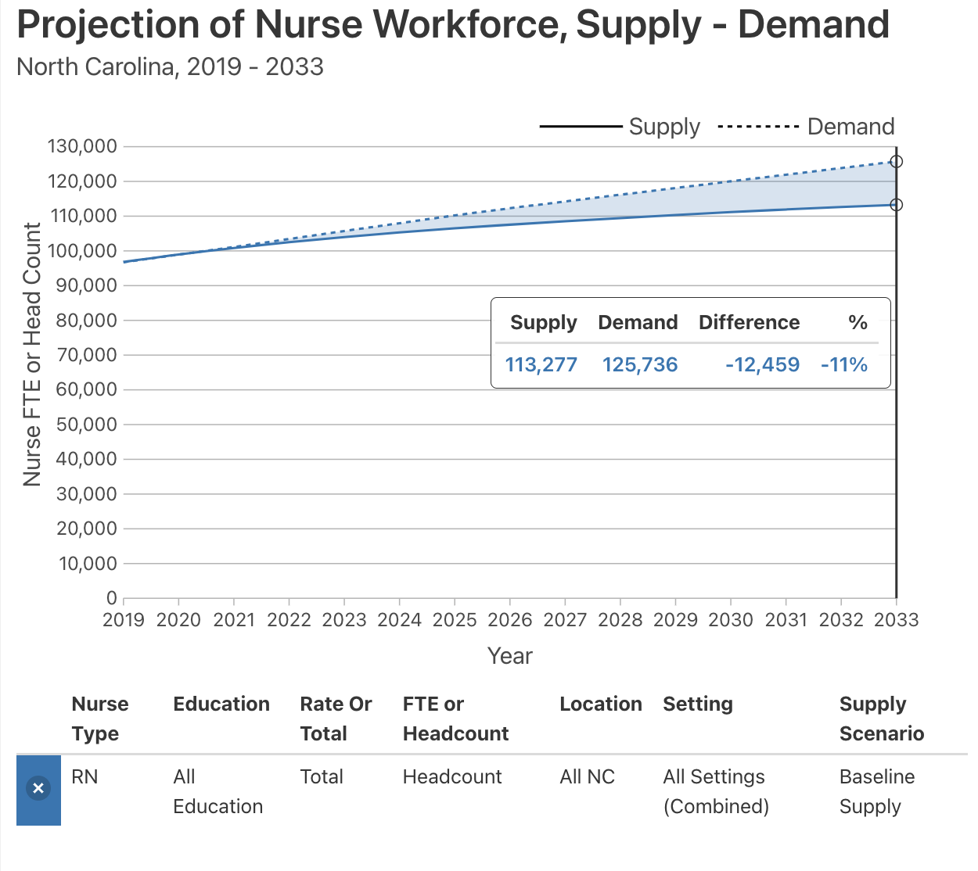
Baseline projected shortage of 12,459 RNs in 2033.
This projection is created from historical data and notably does not account for the COVID-19 pandemic.

Slide 7
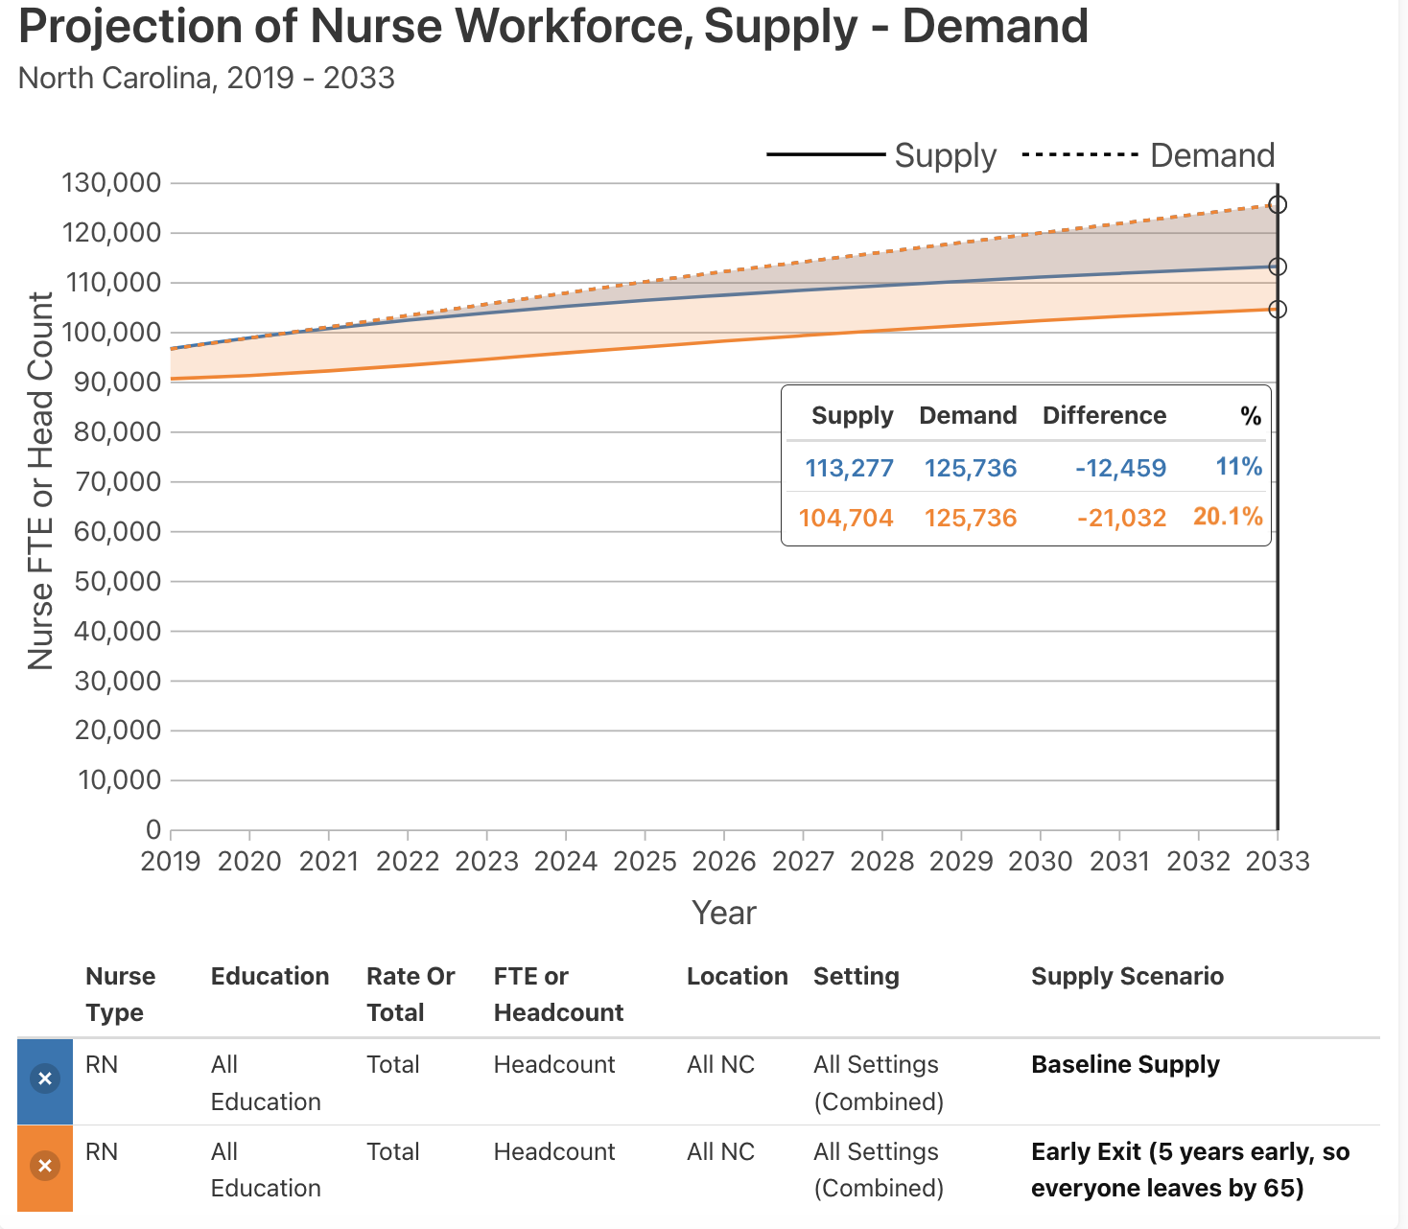
Burnout scenario (RNs exit 5 years early, by age 65) worsens the RN shortage by 9.1% in 2033.
This is one possible impact of the Covid-19 pandemic on nursing supply and demand.

Slide 8
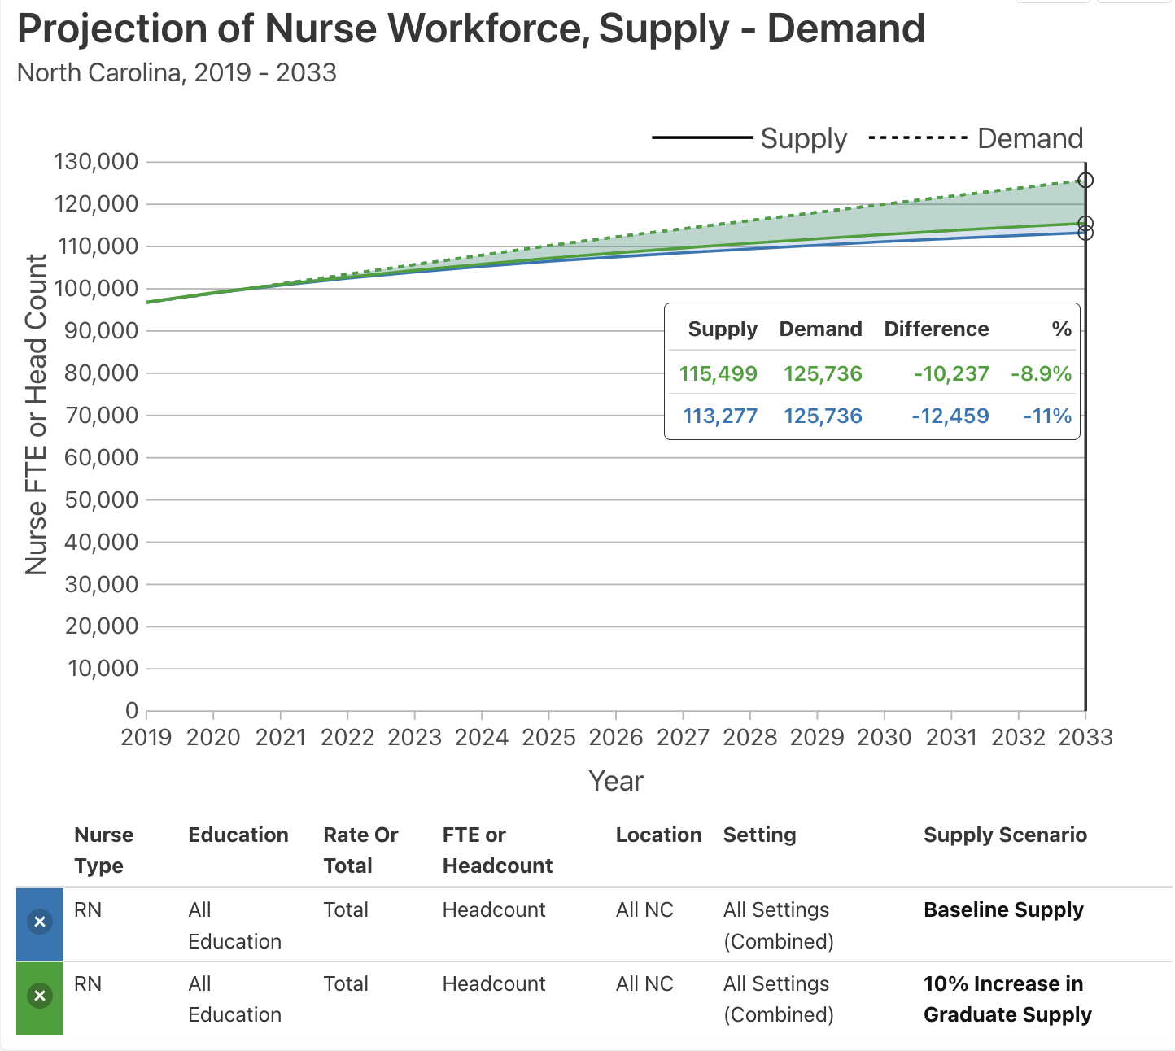
Increased graduate scenario (10% increase in graduate supply) improves the RN shortage by 2.1% in 2033.
Current interventions and policy are targeted at increasing nursing graduate supply, but addressing the shortage completely will require additional interventions.

Slide 9
Retention and Reengagement of RNs
Project aims to leverage the longitudinal files created through the HPDS modernization project (HPDS Version 2) to analyze the number and characteristics of registered nurses who have exited or re-entered the workforce.
Initial years of interest are 2020 to 2023
This analysis will help to target interventions toward RNs mostly likely to leave, identify RNs who would be qualified to be reengaged to the workforce, and understand characteristics of those that have left or re-entered the workforce.
Simultaneous literature review on existing best practices to retain healthcare workers and reengage professionals who have exited the workforce.
Project stakeholders: Sheps Center, NC Board of Nursing, NC AHEC, NC Nurses, Nursing Associations, Employers, Policy Makers

Slide 10
Methods
Write queries in SQL to retrieve and manipulate RN datasets from HPDS V2 database using the pgAdmin tool for PostgreSQL
Window functions
Common table expressions
Subqueries
Joins with crosswalk tables
Table creation
Use Python Pandas to manipulate data frames for initial analysis
Create data visualizations to make comparisons and answer research questions
Tableau
Observable Plot in Javascript
Deliverables created throughout the course of the internship in the form of data visualizations and team meeting presentation

Slide 11
Dataset Creation
RN licenses must be renewed every 2 years
Upon license renewal, the nursing board receives updated data on individual
Must take 2-year cycle into account to analyze data accurately
Approach:
Subset data by RNs who renewed licenses in 2020
Analyze same individuals 2 years later in 2022 to determine retention or exit
Compare groups in 2020 to determine factors that predict retention or exit

Slide 12
2020 – 2022 Analysis Cohort
50,529 RNs renewed a license in 2020 in NC
Of those:
43,288 RNs were active in 2022 (retained)
7,241 RNs were inactive in 2022 (exited)
85.67% retention 2020 – 2022

Slide 13
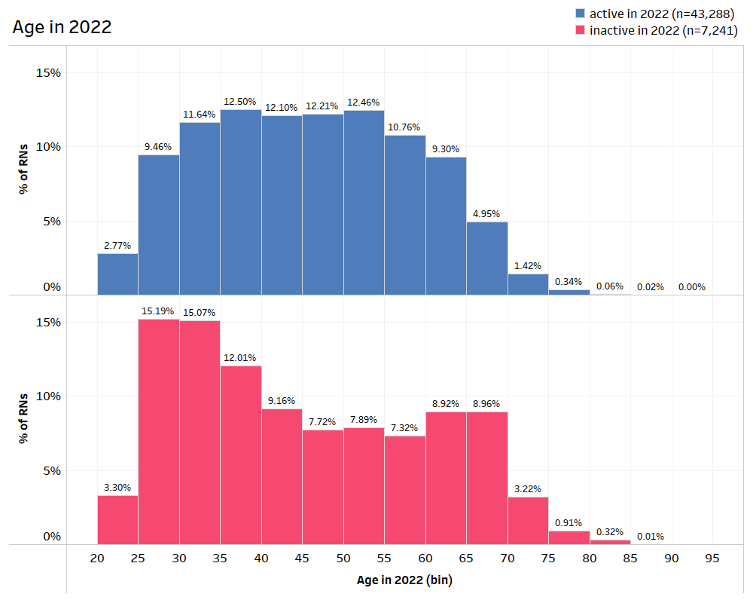
Age Breakdown
Age in 2022
RNs who exited the workforce in 2022 were more likely to be early career (25-35) or late career (>65)

Slide 14
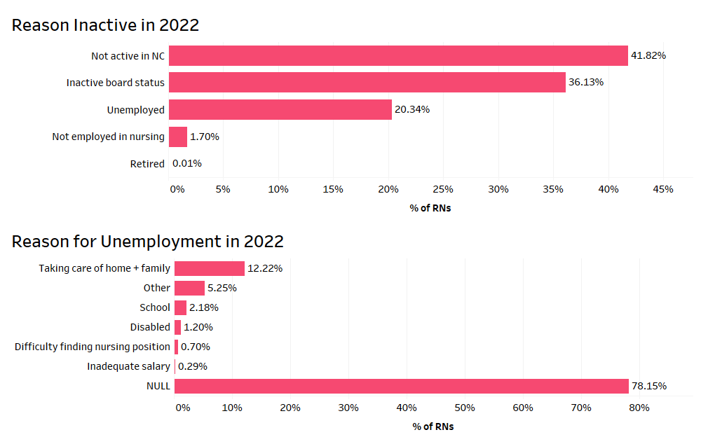
Why did RNs exit the workforce in 2022?
inactive in 2022 (n=7,241)
Reason Inactive in 2022
Reason for Unemployment in 2022

Slide 15
What factors may have contributed to retention or exit of RNs from the NC workforce?
Comparison of groups using 2020 data

Slide 16
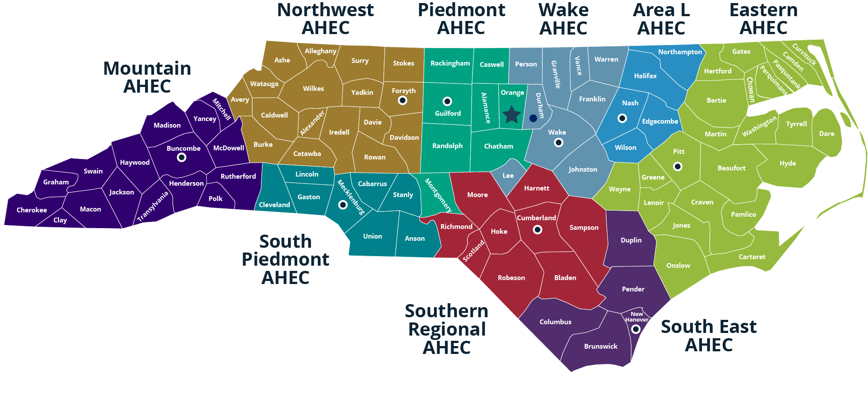
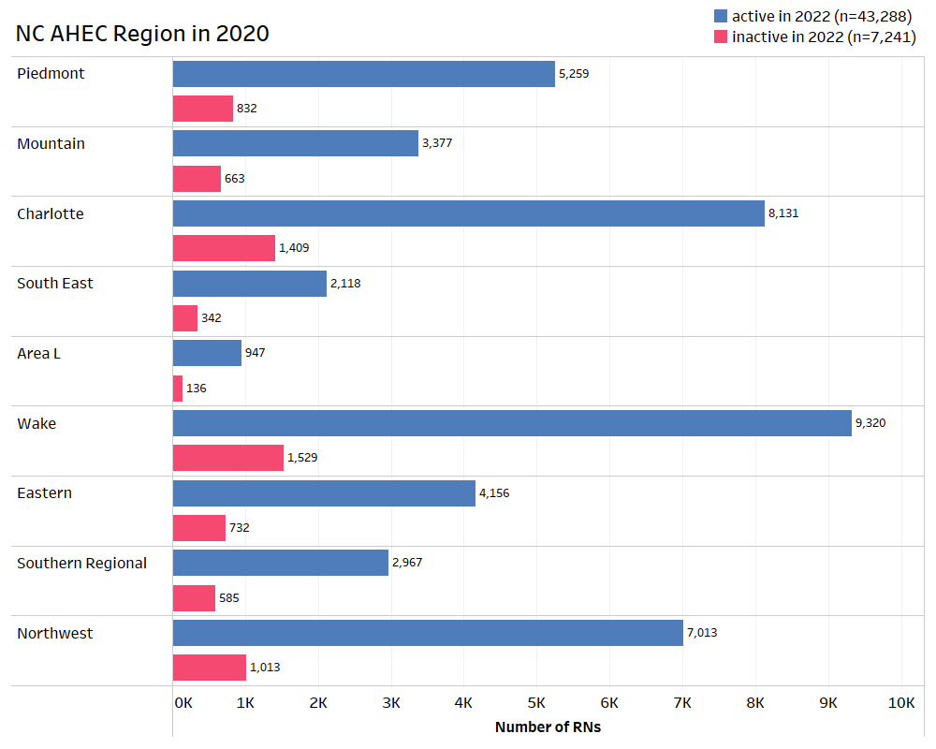
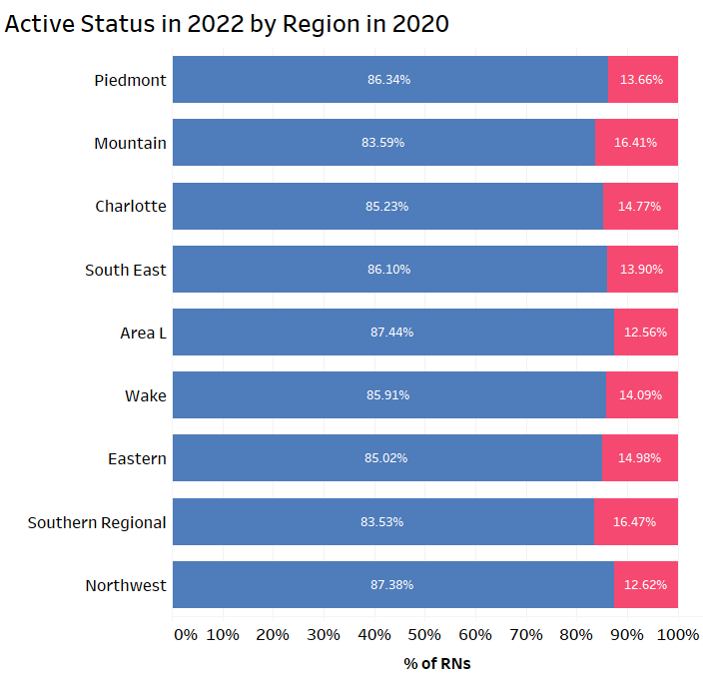
Regional Impact on RN Retention
(Charlotte)
NC AHEC Region in 2020
Active Status in 2022 by Region in 2020

Slide 17
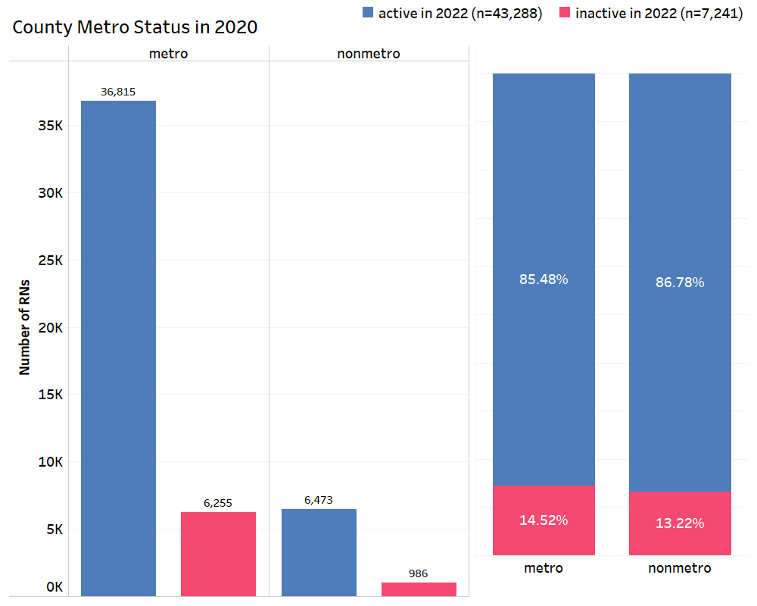
County Rurality Impact
County Metro Status in 2020
There appears to be no impact of metro vs nonmetro county status on retention of RNs

Slide 18
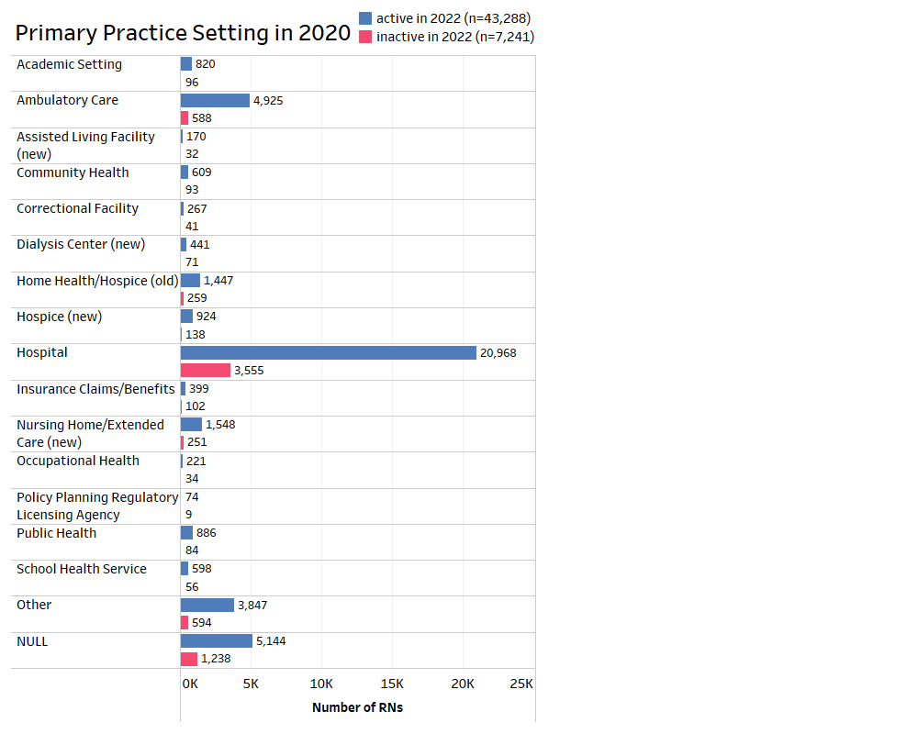
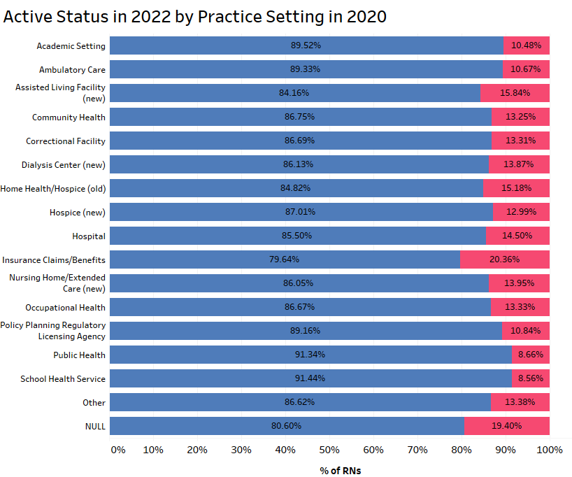
Impact of Practice Setting
Primary Practice Setting in 2020
Active Status in 2022 by Practice Setting in 2020

Slide 19
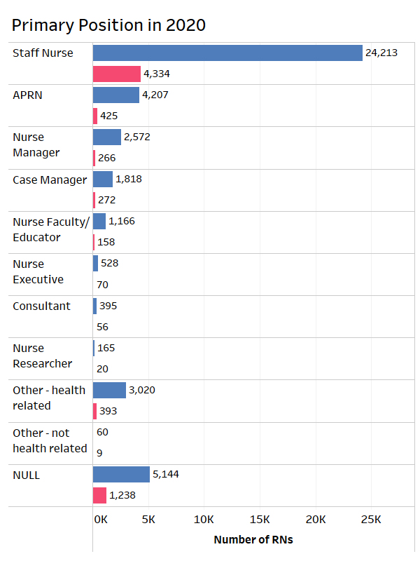
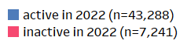
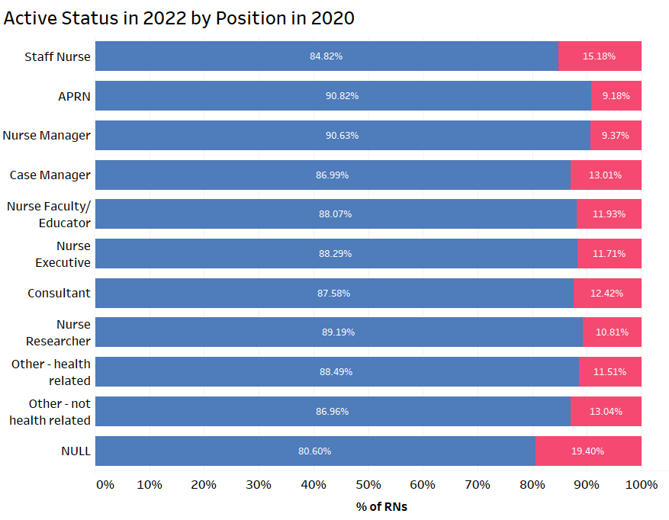
Impact of Nursing Position
APRN (Advanced Practice Registered Nurse) includes NP, CRNA, CNM, CNS
Primary Position in 2020
Active Status in 2022 by Position in 2020

Slide 20
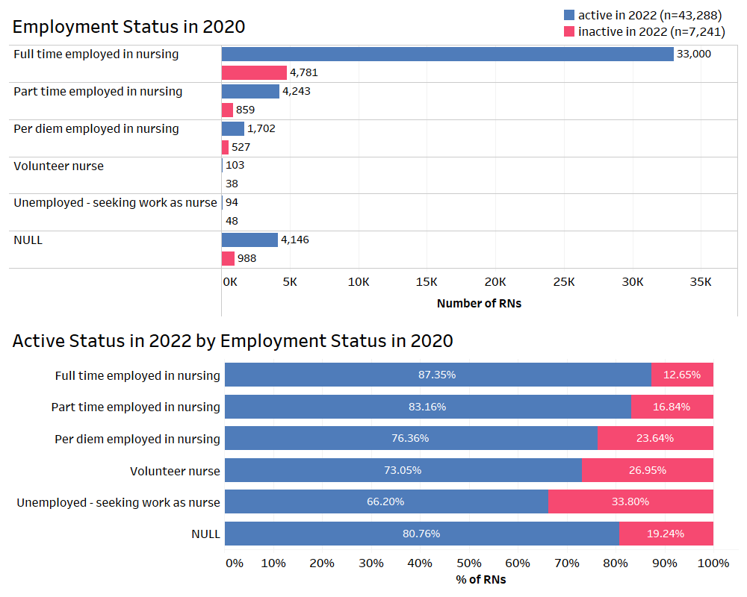
Impact of Employment Status
Employment Status in 2020
Clear trend that more engagement in the RN workforce is correlated to more retention. It appears those who work less time or less reliably, are more likely to leave the workforce in the near future.
Active Status in 2022 by Employment Status in 2020

Slide 21
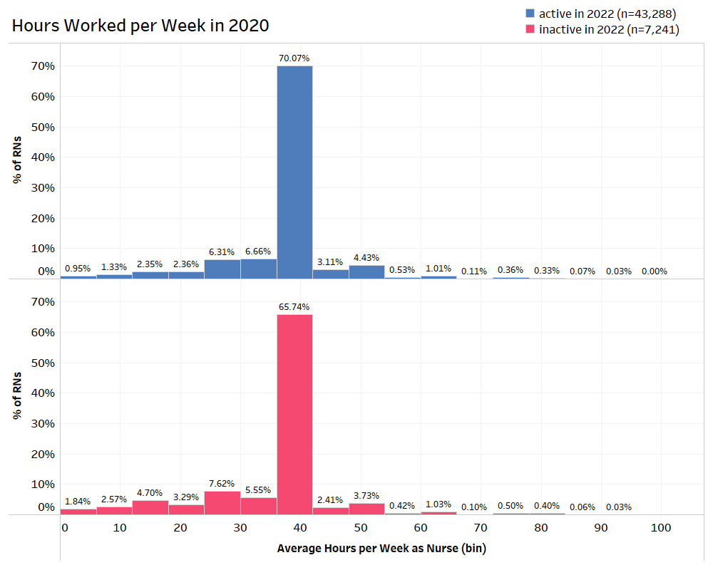
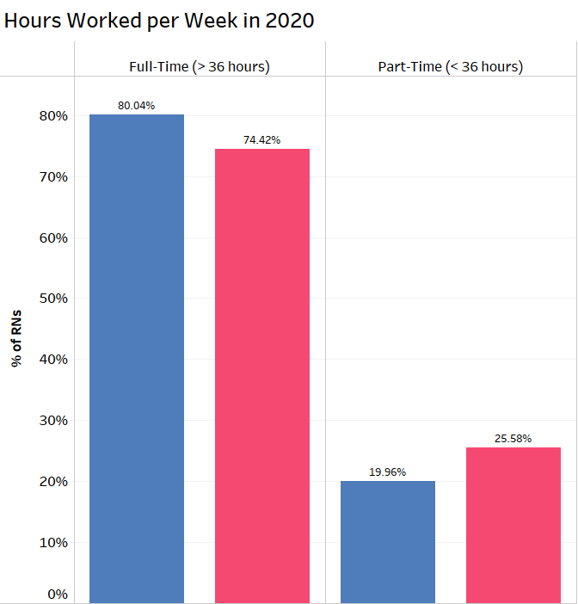
Impact of Hours Worked
Hours Worked per Week in 2020
Full Time (>= 36 hours)
Part Time (< 36 hours)
A higher proportion of RNs who left the workforce were part-time, working less than 36 hours per week, compared to RNs who were retained in the workforce from 2020-2022.

Slide 22
Do the observed trends persist through time to other analysis cohorts?
Use later analysis cohort to see if trends continue
Use earlier analysis cohorts to control for effect of Covid-19

Slide 23
Additional Analysis Cohorts using Same Methods
 | 2016 – 2018 Cohort | 2017 – 2019 Cohort | 2020 – 2022 Cohort | 2021-2023 Cohort
Total RNs with Renewed License | 46,253 | 48,961 | 50,529 | 52,461
Active RNs 2 years later | 41,056 | 42,139 | 43,288 | 44,521
Inactive RNs 2 years later | 5,197 | 6,822 | 7,241 | 7,940
Percent of RNs Retained | 88.76% | 86.07% | 85.67% | 84.86%

Slide 24
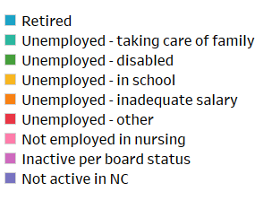
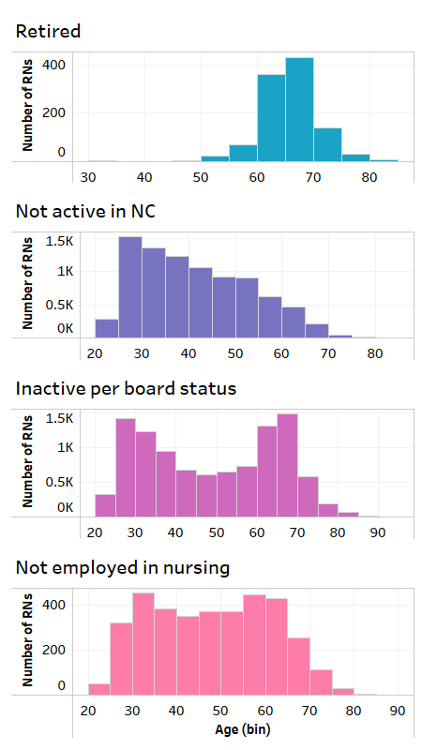

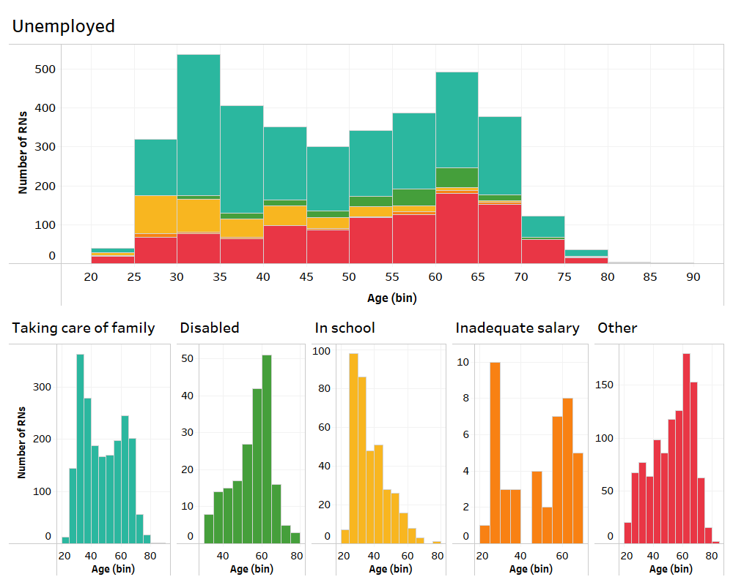
Breakdown of Reason Inactive by Age (inactive group for all analysis cohorts)
Reason Inactive by Age for all Cohorts
n = 27,200

Slide 25
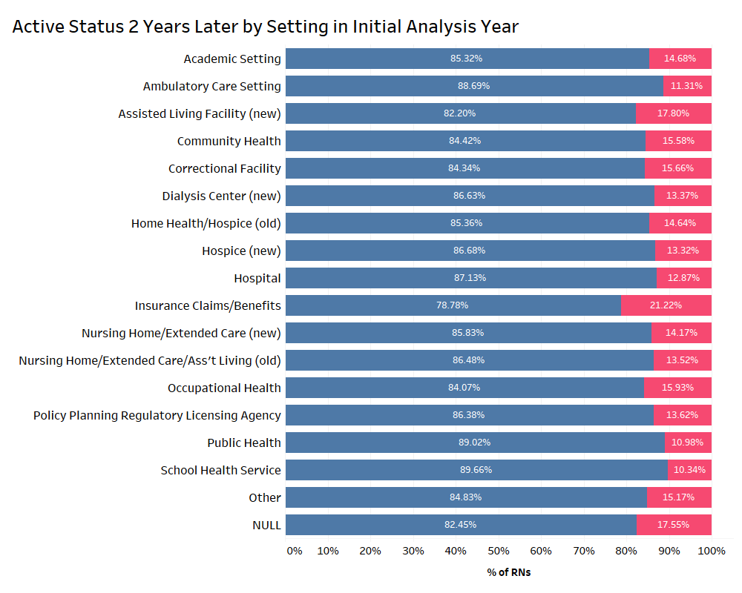

Setting
Active Status 2 Years Later by Practice Setting in Initial Analysis Year
In ambulatory care, public health, and school health service settings, RNs were more likely to be retained.
In insurance claims/benefits and assisted living facility settings, RNs were more likely to exit the workforce.

Slide 26
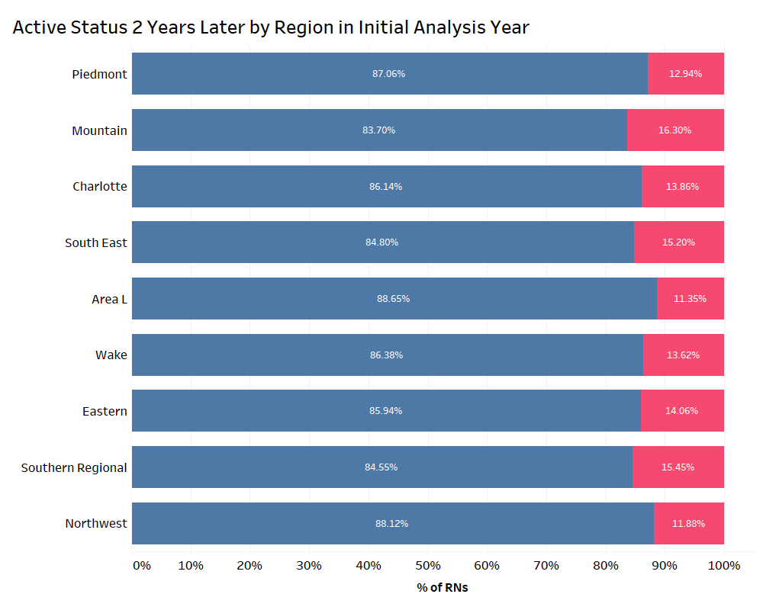
Region
Active Status 2 Years Later by Region in Initial Analysis Year
In Area L and Northwest AHEC regions, RNs were more likely to be retained.
In Mountain, Southeast, and Southern Regional AHEC regions, RNs were more likely to exit the workforce.

Slide 27
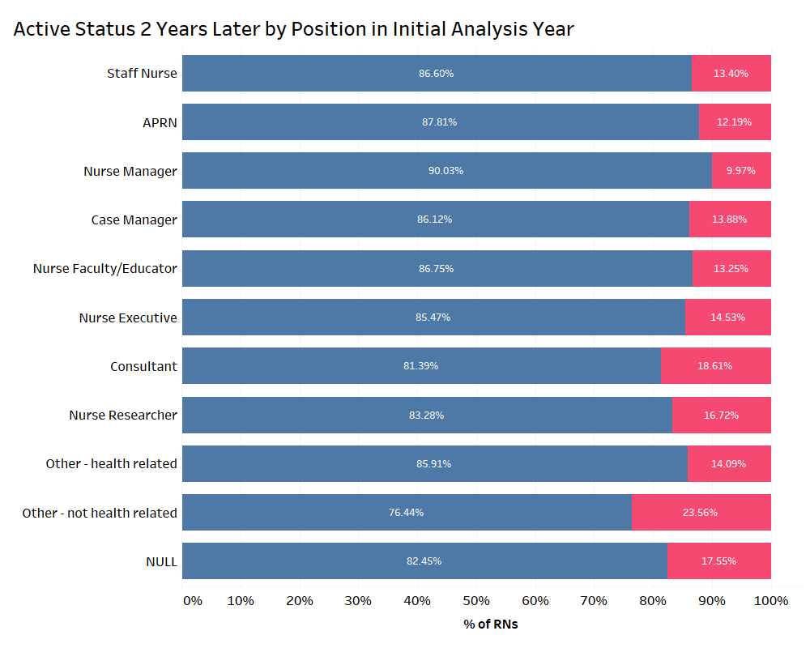
Position
Active Status 2 Years Later by Position in Initial Analysis Year
Advanced Practice Registered Nurses and Nurse Managers were more likely to be retained. Both of these positions represent more advanced RN positions.
Consultants and Other not health related positions were more likely to exit the RN workforce.

Slide 28
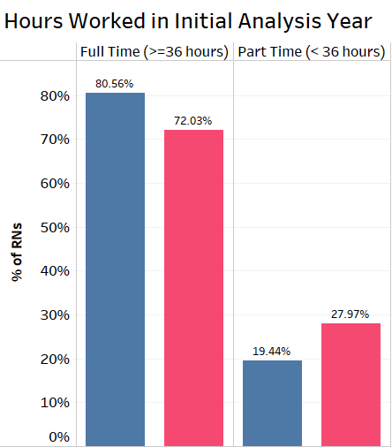
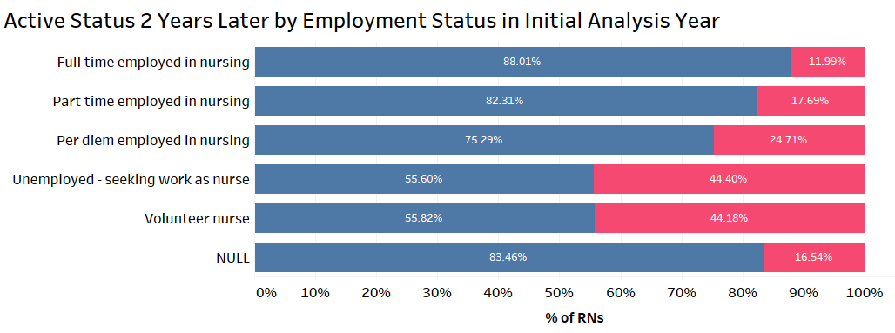
There is a positive correlation between retention and the level to which RN is engaged in the workforce
Hours Worked in Initial Analysis Year
Active Status 2 Years Later by Employment Status in Initial Analysis Year

Slide 29
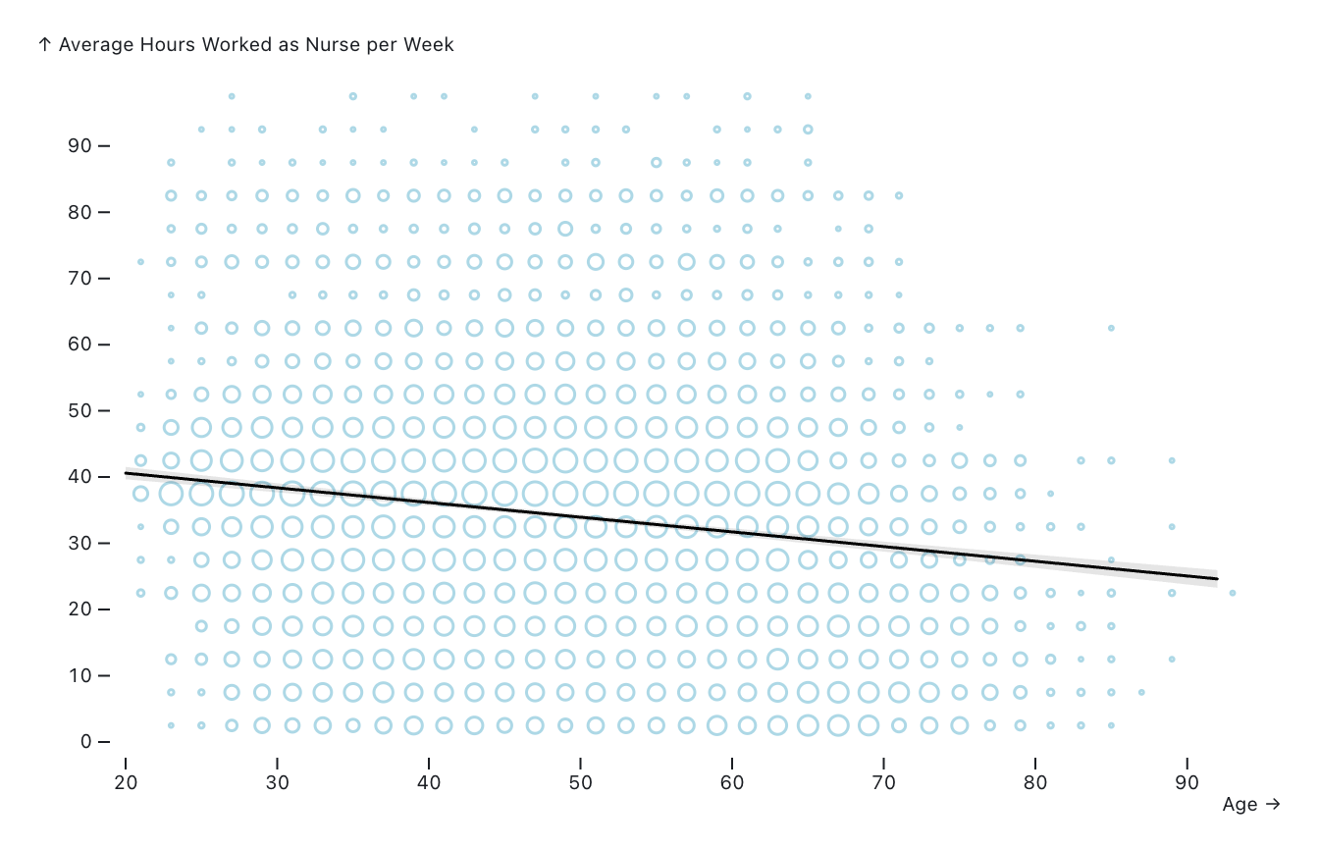
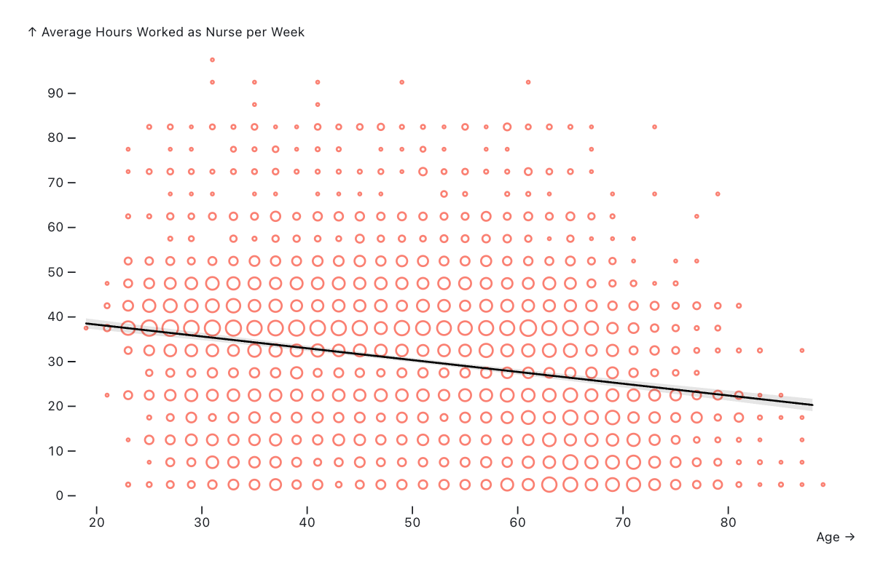
There is a negative correlation between age and hours worked per week for both RN groups
Active 2 years later
Inactive 2 years later

Slide 30
Limitations
Null data
The nursing board collects data from nurses in NC which is transferred to HPDS
A lot of the data is self-reported and contains optional fields
Hidden information within variables
In order to store data in a database, some information must be simplified
There can only be one value per variable
Annual data and 2-year license renewal cycle
License renewal cycle makes longitudinal RN data is less continuous because data is usually only updated every 2 years
Cannot visualize trends at higher time resolution

Slide 31
Conclusions and Findings
New strategies must be implemented to address the projected nursing shortage in NC in addition to increasing nursing graduates.
The rates of RN retention in North Carolina appear to be decreasing, emphasizing the need for intervention to address the nursing shortage.
The observed trends that influence retention or exit from the workforce can inform targets for retention and reengagement interventions.
RNs that exit the workforce are mostly early career or late career
Early career RNs who exit may be best candidates for intervention
Reasons for unemployment can inform where additional support for RNs is needed to improve retention and reengagement
For example: unemployed and taking care of family or seeking nursing work
RNs that work less than full time are much more likely to exit the workforce
Less than full time RNs would be good candidates for intervention
The state regions, positions, and practice settings with higher rates of exit can be focuses of retention and reengagement interventions

Slide 32
Future Directions
For me:
Create blog post about this work and my findings to be posted on the NC Health Workforce Website
For Sheps:
Continue literature search to determine best practices to retain and reengage RNs to the workforce
Continue data analysis to determine targets for intervention and additional predictive factors
Additional years and analysis cohorts
Analyze RNs with data that reflects reengagement to the workforce
Eventually report findings that will inform policy and interventions to increase retention and reengagement of RNs in NC to address the shortage

Slide 33
Thank you!
Especially to my mentors, Evan Galloway and Abhi Joshi

Slide 34
Resources
The Program on Health Workforce Research and Policy at the Cecil G Sheps Center. “NC Nursecast: A Supply and Demand Model for Nurses in North Carolina.” November 1, 2021. https://ncnursecast.unc.edu/model/
North Carolina Health Professions Data System, Program on Health Workforce Research and Policy, Cecil G. Sheps Center for Health Services Research, University of North Carolina at Chapel Hill. Created December 04, 2024 at https://nchealthworkforce.unc.edu/interactive/supply/

